Slide 1
Quantum Computing for Drug Discovery
Trung Vu
https://youtu.be/UqrfxJBg3cA

Slide 2
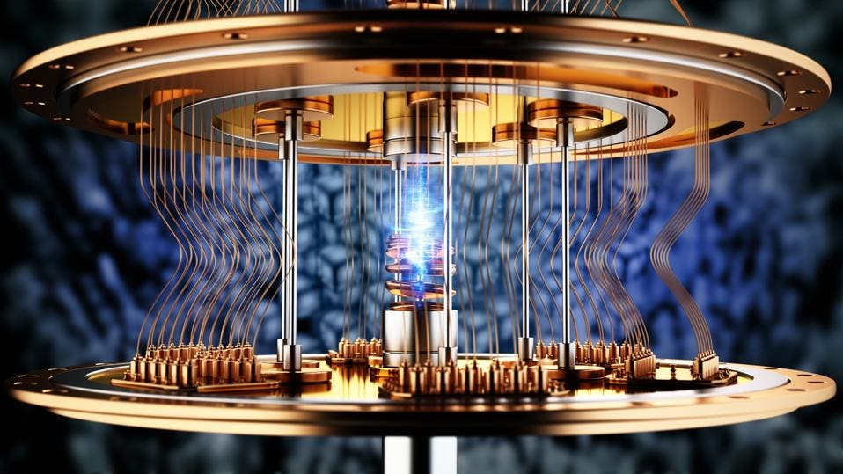

Clearing Up Things
“quant” does NOT mean “quantum”
“quant” refers to “quantitative (financial) analysis”
The term captures people who use mathematical models to make predictions on various markets, using logic and reasoning to navigate investments
Quantum computing is currently being explored in quant, but they are NOT the same

Slide 3
What is Quantum Computing
quantum computing – “emergent field of cutting-edge computer science harnessing the unique qualities of quantum mechanics to solve problems beyond the ability of even the most powerful classical computers” (IBM)
Advantage: have the potential to solve problems that conventional computers can’t due to…
Impractical run-times
Significant computational complexity
Reality: still a young field; don’t deliver on their promises yet

Slide 4
Necessary Definitions
Superposition – state in which a quantum particle can represent a combination of multiple possibilities; a qubit can be in multiple states at once
Entanglement – when qubits have some relationship that prevents them from acting independently
occurs when quantum particle has a state (i.e. spin, charge) that’s linked to another quantum particle’s state
Decoherence – process where quantum particles and systems can decay, collapse or change, losing its quantum state
Interference – when entangled quantum states can interact and produce more/less likely probabilities

Slide 5
Qubits
Qubit – the quantum version of a classical computer’s most basic form of information, bits
Created by manipulating and measuring quantum particles (e.g. photons, electrons, atoms, etc.)
Can store zero, one, or weighted combination of zero and one (superposition) → more data than bits → better computational ability
Qubit can only output single bit of information at end of computation

Slide 6
How Qubits are Created
Scientists find spot in material where quantum properties can be accessed/controlled
Use light or magnetic fields to create superposition, entanglement, and other properties
One way is manipulating the spin of individual electrons
Electron spin is either up (highest energy state), down (lowest energy state), or combination of both
Microwaves and magnets applied to manipulate spin and control qubit

Slide 7
Different Types of Qubits
Superconducting
Trapped ions
Quantum dots
Photons
Neutral atoms

Slide 8
Challenges with Qubits
Qubits need to be cooled to temperatures a fraction of a degree higher than absolute zero to guarantee spin state (coherence)
If not, there is too much energy and the qubit will just randomly fluctuate between states
Qubits sensitive to environment and don’t maintain state for long
Bad because that means information can change randomly
Even under the right conditions, qubits can fail due to decoherence
Quantum states can interfere with one another to either amplify correct answers (good) or push wrong answers (bad)
Problem increases in scale as number of qubits used increases

Slide 9
How Quantum Computing Works
Initialization
Set up qubits in a well-defined initial state
Different depending on what problem you are trying to solve and the input
Computation
Apply a series of quantum operations (quantum gates, etc) to manipulate the qubits
Such operations will leverage superposition and entanglement to explore a large computational space, allowing quantum computers to surpass limitations of classical computers
Measurement
Record the final state of qubits
The measurement process will collapse the superposition of qubits into either state 0 or 1
This stage is general done multiple times to ensure that the answer returned is accurate

Slide 10
Applications of Quantum Computing
AI and ML
Enhance ML algorithms and enable stronger AI models due to quantum computers’ greater computational capability
Optimization problems
Can find optimal solutions for problems in logistics, finance, etc.
E.g. portfolio optimization, financial modeling, warehouse logistics
Cryptography
Can break current encryptions fast, but also create stronger ones
Drug discovery
(will expand on in next slides)

Slide 11
What is Drug Discovery?
Drug discovery is a field in the medical industry that involves discovering new medications
How cures to diseases (e.g. COVID-19) are found
Traditionally done using physical testing of compounds
Put experimental compound on trays with each of the testing compounds → wait → record results → repeat
This is a very time-consuming process
Technological evolutions moved physical process to software
Virtual screening and docking allows for faster experimentation (a few seconds)
However, there are over 10¹⁶ compounds out there → lots of time overall
GPU computing and AI can help, but both have limitations

Slide 12
Drug Discovery in Quantum Computing
Heart of drug discovery is to understand molecular behavior
How do molecules interact? What is their stability? Energy state? Etc.
Notice that these questions are fundamental traits of a quantum computing problem
Simulating molecules and materials at unprecedented levels of detail via quantum computing can lead to discovery of new drugs not possible with GPU and/or AI
Applications
Calculating ground state energies to identify most stable configuration(s)
Identify binding energies between a drug and target protein
Predict reaction rates to different candidate drugs
The more simulations and results we get, the faster, cheaper, and more successful drug design will be

Slide 13
IBM Qiskit
IBM Qiskit – an open-source SDK for working with quantum computers at level of circuits, pulses, and application modules
Allows building of quantum circuits, simulation (locally or cloud), executing on real quantum hardware (cloud), and post-analysis
Contains various libraries for specific applications
qiskit-algorithms → algorithms like Grover (search) and VQE
qiskit-nature →many methods for chemistry and physics problems
qiskit-primitives
qiskit-circuit → collection of circuits and building blocks for algorithms or benchmarks (e.g. EfficientSU2)

Slide 14
Demo: Estimating Electronic Ground State Energy of H₂ using VQE
Goal: find electronic ground state energy (lowest possible energy) of Hydrogen molecule H₂
Why:
Electronic ground state energy helps determine molecule’s stability, reactivity, and binding affinity which helps predict its behavior in the body and its potential as a drug candidate
Electronic ground state energy of H₂ can be easily calculated classically, but H₂ is the “hello world” of molecules
Electronic ground state energy of more complex molecules cannot be calculated as easily
Demo shows process that can be applied to other, more complex, molecules
What is VQE?
Variational quantum eigensolver (VQE)
A hybrid quantum-classical algorithm
Hybrid part → prepared parameterized trial wavefunction (ansatz) and measures its energy
Classical part → optimizes parameters of the ansatz to find lowest energy

Slide 15
Demo: High-Level Explanation
#1 Create Hamiltonian for H₂
Hamiltonian describes the energy of the molecule
H₂ at ~0.735 Angstrom can have its energy operator represented using 2 qubits
#2 Initialize Ansatz circuit
Ansatz circuit is a parametrized quantum circuit that creates our trial wavefunction
EfficientSU2 used for demo; hardware-efficient ansatz suitable for chemistry problems
Other ansatz circuits include UCC and UCCSD
When fed to the VQE, VQE will try to find the best parameters for the ansatz
#3 Initialize optimizer and estimator
Sequential least squares programming (SLSQP) optimizer commonly used with VQE; SPSA is another option
Estimator primitive computes expectation values of observables with respect to states prepared by quantum circuits
#4 Initialize and run VQE algorithm to find electronic ground state energy
VQE initialized with ansatz, optimizer, and estimator as parameters
VQE prepares state, measures energy, and adjusts settings until lowest possible energy found
Minimum eigenvalue of VQE computed and dictates calculated electronic ground state energy of H₂ molecule

Slide 16
Demo: Create Fermionic Hamiltonian for H₂
H₂ atoms and x-, y-, z-coordinates initialized in arrays
Saved to Molecule object with charge 0, multiplicity 1, and Angstrom distance
Charge – the total charge of the molecule
Multiplicity – the multiplicity of the molecule (= 2*spin + 1)
Units – distance unit for xyz coordinates; angstrom (10⁻¹⁰ meter) used
PySCFDriver used to get properties of H₂ molecule using classical calculations; good for obtaining reference values
Classical calculations fine for H₂, but what about when molecules grow too complex to be solved using classical computation?

Slide 17
Demo: Convert fermionic Hamiltonian to qubit
Goal: represent molecule energy in a way that a quantum computer can process; involves mapping fermionic Hamiltonian to qubit Hamiltonian
Different types of mapping algorithms:
Jordan-Wigner
Intuitive for small systems, but inefficient for large-scale simulations due to linear scaling
Parity
Good for simplifying Hamiltonians in molecules with spatial symmetries
Bravyi-Kitaev
Good for large-scale simulations due to logarithmic scaling

Slide 18
Demo: Initialize Ansatz Circuit, Optimizer, Estimator
EfficientSU2 ansatz circuit initialized with 2 qubits, linear entanglement, and 2 reps
Entanglement – linear entanglement connects qubits sequentially
Reps – # of layers of rotation and entanglement blocks; higher → more complex states
Other ansatz circuits include UCC, UCCSD
Sequential least squares programming (SLSQP) optimizer commonly used with VQE
Other optimizers include SPSA
Estimator – quantum primitive used to calculate expected value of the qubit Hamiltonian for a given ansatz state

Slide 19
Demo: Initialize VQE
Built using ansatz, optimizer, and estimator
A hybrid algorithm with a quantum and classical component
Quantum part – prepares a trial quantum state (AKA guess for molecule’s electron configuration) on a quantum computer (simulator here) using an ansatz, then measures its energy using qubit Hamiltonian
Classical part – takes the measured energy and adjusts the parameters of the ansatz to try and find a lower energy
Both components repeat until a lower energy cannot be found

Slide 20
Demo: Running VQE
Minimum eigenvalue of VQE is found over various iterations
The result is the estimated electronic ground state energy of H₂
Comparing the estimated value to that the classically calculated value shows nearly identical results
VQE performed well!
Plots shows convergence of estimated energy over the iterations

Slide 21
What’s the Big Deal?
Shown that quantum computing can be leveraged to compute the electronic ground state energy of a molecule
Classical calculations are fine for simple molecules like H₂, but will take prolonged periods of time for complex molecules
Quantum computing can help solve this problem
Electronic ground state energy helps determine molecule’s stability, reactivity, and binding affinity which helps predict its behavior in the body and its potential as a drug candidate
Quantum computing can accelerate drug discovery process and help scientists/researchers quickly, cheaply, and reliably produce new cures to detrimental diseases

Slide 22
References
https://www.ibm.com/think/topics/quantum-computing
https://aws.amazon.com/what-is/quantum-computing/
https://www.energy.gov/science/articles/creating-heart-quantum-computer-developing-qubits#:~:text=To%20create%20a%20qubit%2C%20scientists,%2C%20entanglement%2C%20and%20other%20properties
https://qiskit-community.github.io/qiskit-nature/tutorials/01_electronic_structure.html
https://qiskit-community.github.io/qiskit-nature/howtos/vqe_ucc.html
https://medium.com/qiskit/what-are-qiskit-primitives-9bf63c1eacc7

